Slide 1
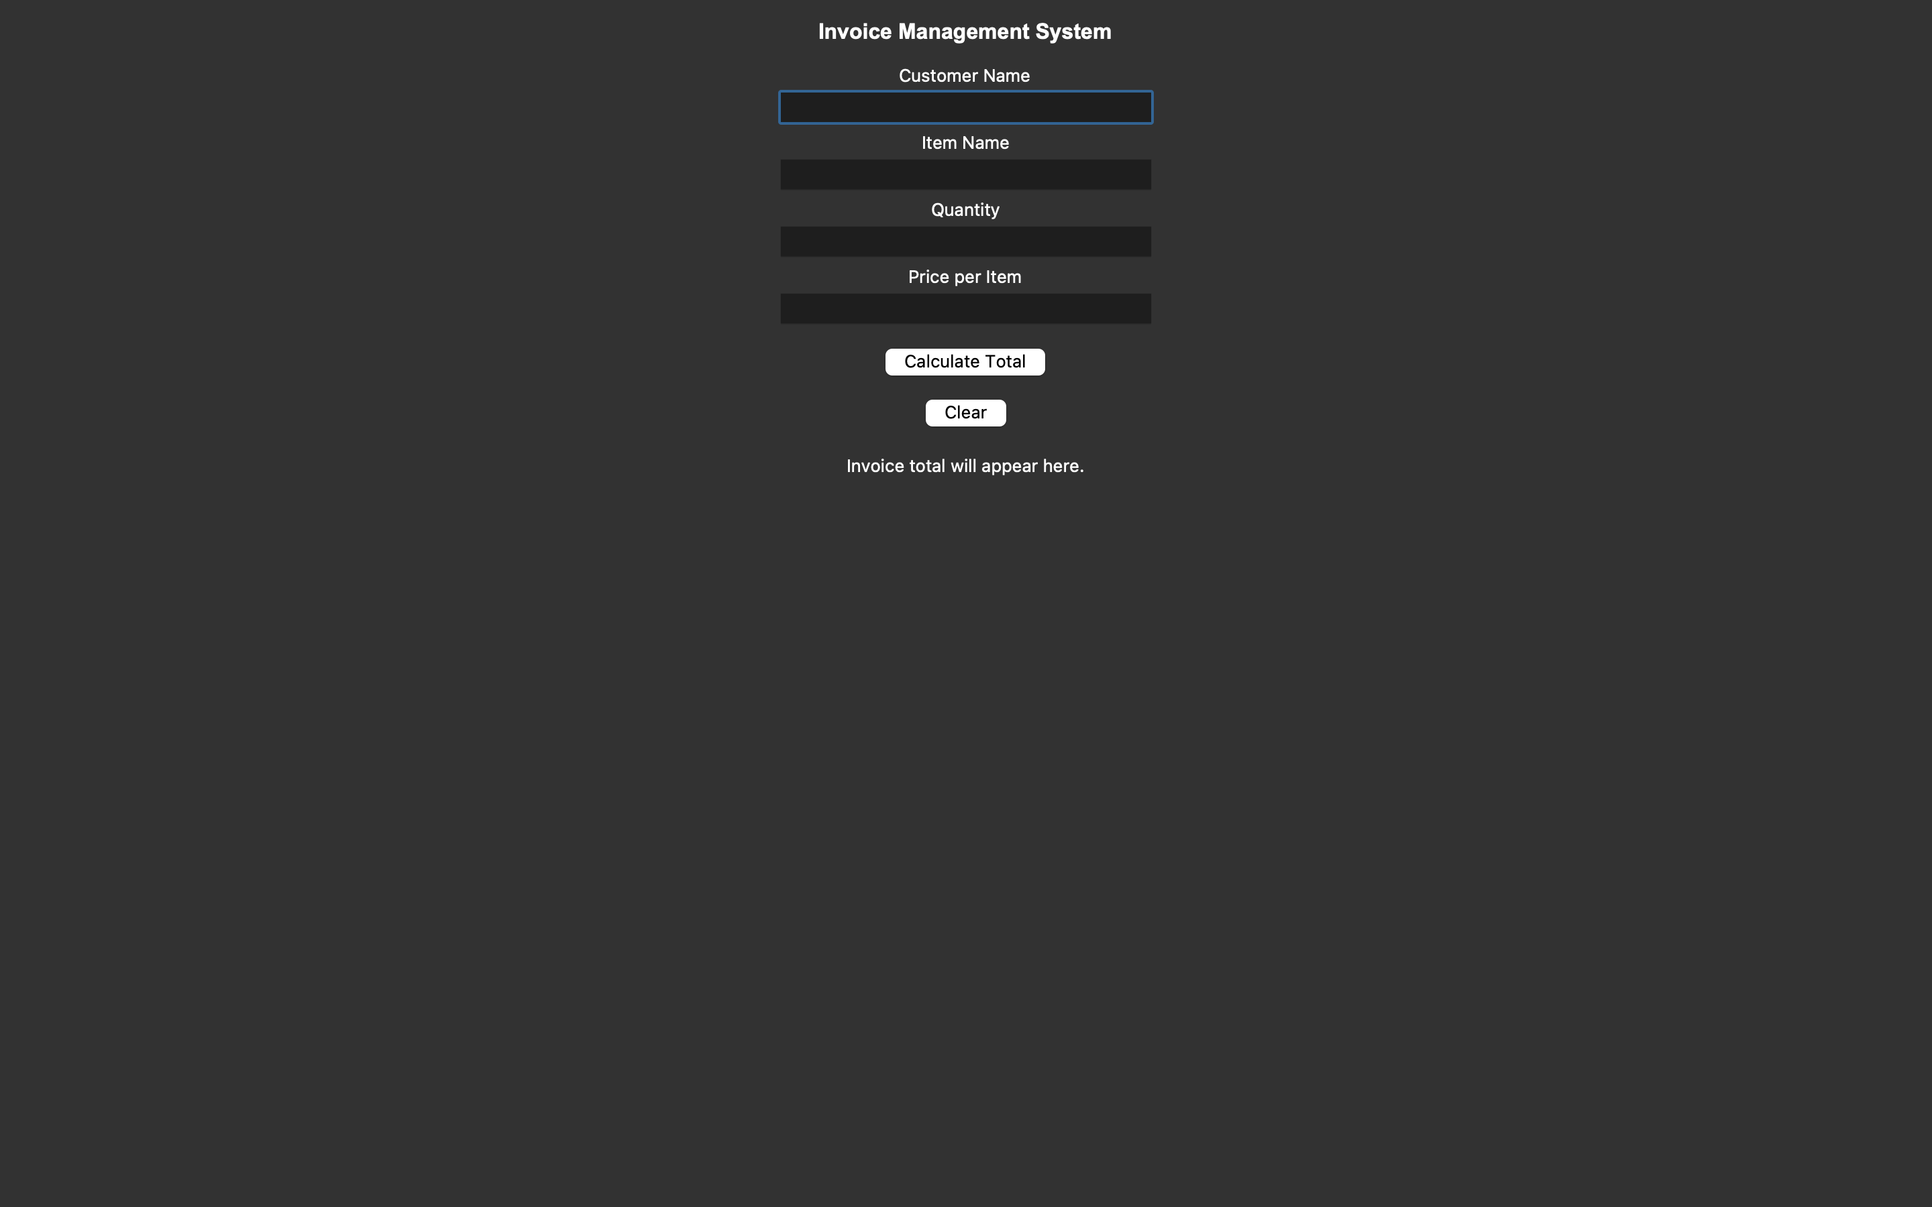
Summit Billing Invoice System
Creating simple invoices quickly and efficiently
Features:
- Enter customer info
- Add item details
- Auto calculate totals
- Clear/reset form

